Slide 1

ALIGARH MUSLIM UNIVERSITY MAGAZINE
MD IRSHAD NADAF / 25CAMSA158

Slide 2
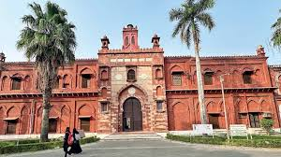

Slide 3


Slide 4


Slide 5
SIR SYED DREAM REGARDING AMU
Sir Syed envisioned AMU as a light of modern education for IndianS
His vision was to create leaders through quality education. AMU stands as a living symbol of his mission.
Sir Syed believed education was the key to social and moral upliftment.

